Slide 1
The Magical Forest

Slide 2
What we will see today
1.Meet the creator
2.Project Overview
3.The Tech Stack

Slide 3
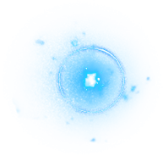
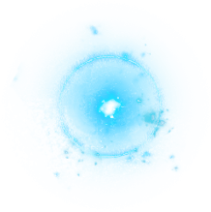
Meet the creator
Hi everyone, and welcome! My name is Ethan, and today I am incredibly excited to present The Magical Forest. For this project, I took on the role of game design, which means I was responsible for the games, making sure our players will have a good time. We built this fantasy web application using a modern foundation of HTML, CSS, and JavaScript, and today is June 13, 2026. Let's step inside and see what we created.

Slide 4
Project Overview
Before we look under the hood at the code, let me give you a birds-eye view of what The Magical Forest actually is. It is a fully interactive, multi-page web application designed to immerse users in a fantasy world. Visitors land on an enchanted gateway page and, upon entering, can explore distinct regional hubs tailored to different mythical creatures. We prioritized smooth transitions, responsive layouts that work beautifully on both phones and desktops, and real-time audio tracking to build a rich, engaging experience from the moment the page loads.

Slide 5
The Tech Stack
To kick off the technical side of our presentation, let’s look at the actual toolbox we used to build this world. Part one of our architecture covers our core tech stack and the collaborative development environment that kept our team organized.

Slide 6
What is HTML?
Every great project needs a solid foundation, and for web development, that is HTML, or HyperText Markup Language. Think of HTML as the structural skeleton of our website. It doesn't handle the pretty colors or the complex logic; instead, it strictly defines the raw content. It tells the browser, 'This is a main heading,' 'This is a navigation link,' and 'This is an interactive button.' Without this clean skeleton, we wouldn't have a canvas to style or program against.

Slide 7
GitHub + GitHub Pages -how the site got online
Because we worked as a engineering team, we couldn't just keep the files on our local computers. We utilized GitHub for version control, which allowed us to track our code changes, merge our work, and avoid overwriting each other's files. Once the code was polished, we deployed it live using GitHub Pages. This cloud platform hosts our repository data, turning our raw code files into a live public URL that anyone in the world can visit in real time.

Slide 8
File Organization
Now that you know what tools we used, let’s talk about file management. Part two covers project architecture, specifically how we organized a massive, multi-page fantasy universe into clean, manageable directories.

Slide 9
Folder structure
As the game maker, one of my biggest priorities was keeping our project tidy. A messy folder structure leads to broken code. We created a modular project tree layout where our core asset folders like CSS for styling, JS for logic, and audio assets live in neat compartments. Furthermore, we isolated our creature hubs into separate sub-directories. This separation of concerns made it incredibly easy for the team to collaborate without stepping on each other's toes."

Slide 10
Css Section
With our structure built and our files organized, it was time to make the forest look magical. Part three focuses on our design, visual styling, and the presentation layer of the application.

Slide 11
What is CSS??
If HTML is the structural skeleton of our forest, CSS—or Cascading Style Sheets—is the skin, clothing, and atmosphere. CSS is what transforms a plain text document into a beautiful, cinematic experience. It controls everything your eyes see on the screen: our mystical typography choices, the deep forest color palettes, the spatial layouts, and the smooth visual animations. It is the ultimate tool for setting a specific mood and aesthetic.

Slide 12
Global Variables
The first major design feature I implemented was CSS Variables. Instead of typing out hex code fifty different times across a massive stylesheet, we stored it once in a central global location. This means if we ever want to tweak our brand colors, we only have to change it in one single line of code, and every single element across the entire website updates automatically. It’s an trick that saves hours of manual editing.

Slide 13
Glassmorphism
To give the user interface a premiumfeel, we utilized a design trend called glassmorphism. You can see this clearly on our main navigation bar and content panels. By applying a specialized backdrop filter, we create a frosted-glass blurring effect. This keeps our text incredibly sharp and easy to read, while still allowing the vibrant, glowing colors of the forest artwork to subtly peak through from behind the container.

Slide 14
Animation
We didn't want our website to be boring so we add animation.By establishing continuous, looping mathematical timelines, we created movements like drifting forest mist and slowly pulsing light particles. Because these animations run directly through the browser’s native graphics engine, they remain smooth without lagging the device

Slide 15
JavaScript -Making It Alive
"We have structure and we have style, but now we need action. Part four explores our system logic, data handling, and the interactivity that brings the world to life.

Slide 16
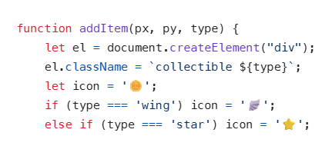
JS feature #1
This is the code to add power ups. The coin give plus 500 magic which is the name of the score.the wing give super jump.And the star make you glow four some time.

Slide 17
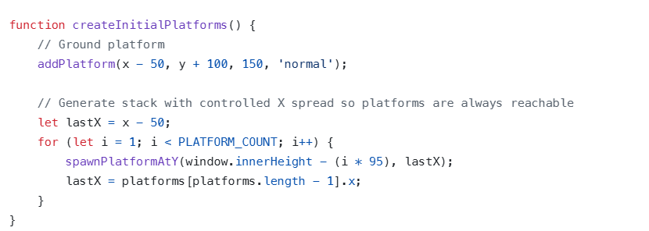
JS feature #2
This let platform spawn. It also make sure you have a spawn platform. Last of all it make sure the platform are spread apart but reachable.

Slide 18
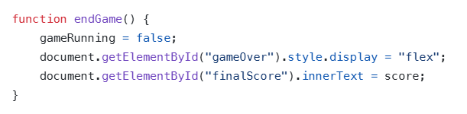
JS feature #3
This make the game end.

Slide 19
Cool Features
To wrap things up, let's take a step back from the raw code. Part five covers our regional game design, the real-world engineering hurdles we conquered, and our live demonstration.

Slide 20
The 3 creature hubs (Dragon, Elf, Pixie)
When you explore the final product, you'll see how our engineering choices shaped the three unique creature zones. The Dragon Hub is built for speed, relying heavily on html arrow interactions. The Elf Hub shifts the focus to high elegance, maximizing advanced CSS typography and layouts. Finally, the Pixie Hub blends both worlds, utilizing dense particle loops to create a whimsical, high-motion atmosphere.

Slide 21
What I learned
I learned about html and css.Also javaScript and how to break down massive programming problems into tiny, solvable steps, and how important clear documentation is when collaborating in a development team

Slide 22
Live demo time

Slide 23
Thanks!
Any questions?
Pls dont ask any

